Slide 1

McDonald’s and there Competitors

Slide 2
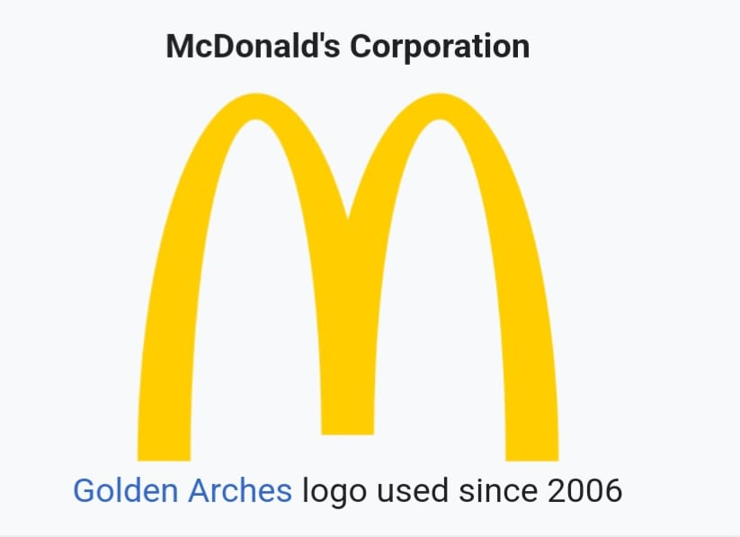
HISTORY OF MCDONALS McDonald's Corporation is an American multinational fast food chain, founded in 1940 as a restaurant operated by Richard and Maurice McDonald, in San Bernardino, California, United States. They rechristened their business as a hamburger stand, and later turned the company into a franchise, with the Golden Arches logo being introduced in 1953 at a location in Phoenix, Arizona McDonald's is also a real estate company through its ownership of around 70% of restaurant buildings and 45% of the underlying land

Slide 3

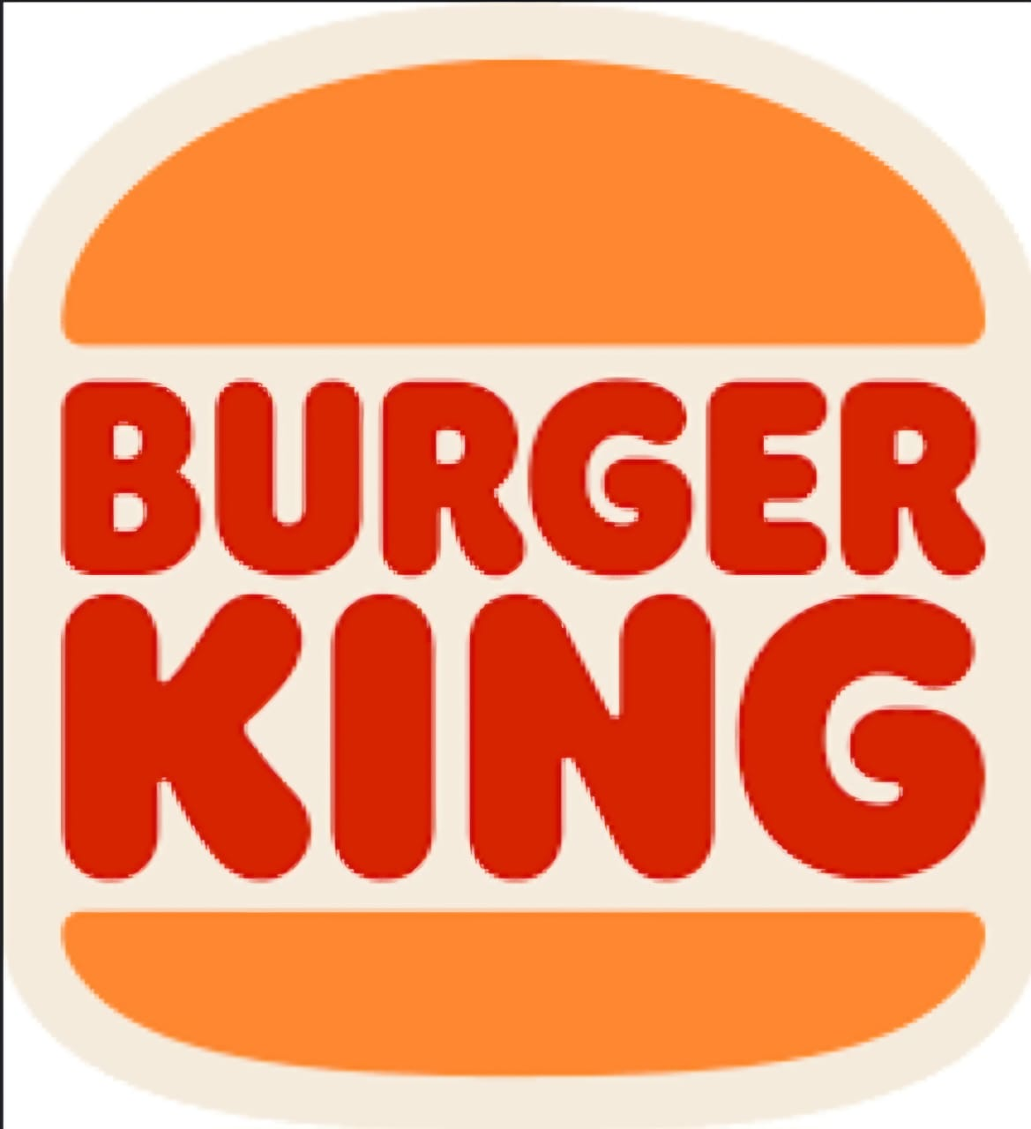
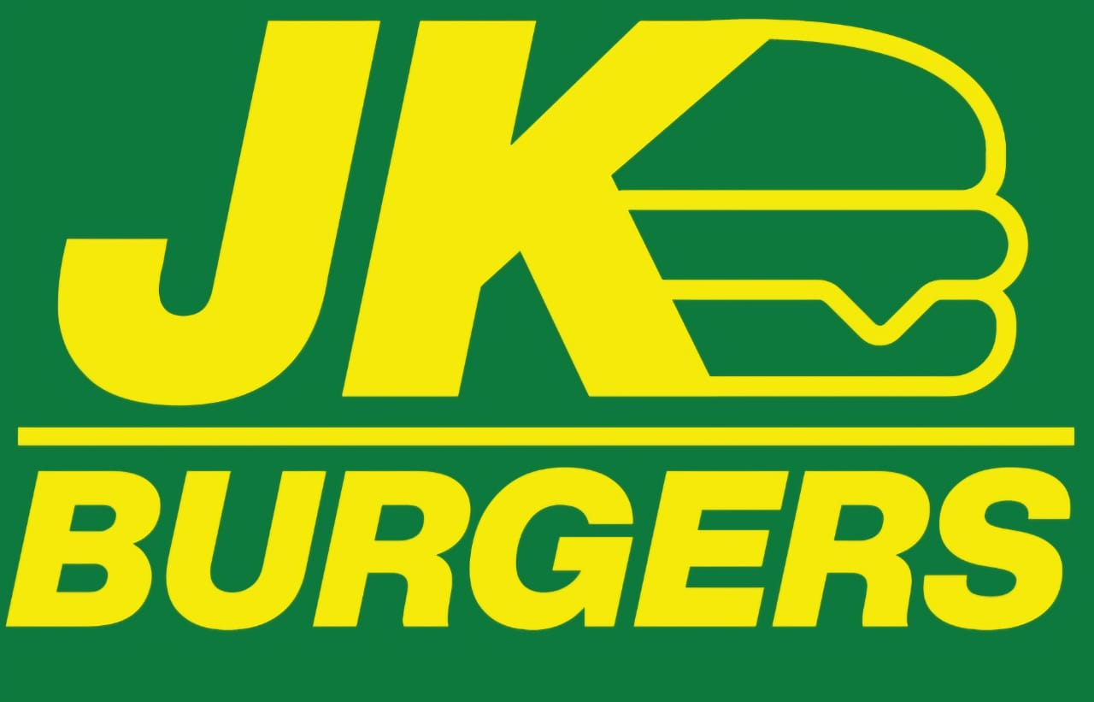
Competitors
McDonald’s
KFC
INDIAN FAST FOOD MARKET
Burger King
Jumboking

Slide 4
Analyzing social media presence
Instagram
Facebook
YouTube
Twitter

